Slide 1
Further Rebuilding Plan Scenarios for Striped Marlin in the WCNPO
ISC Billfish Working Group
Jon Brodziak
Jon.Brodziak@NOAA.GOV
7-May-2024
Notes:
Update on

Slide 2
Open Science for BILLWG
This presentation (WCNPO Striped Marlin 7-May-2024.pptx) is on BILLWG google drive at: https://github.com/PIFSCstockassessments/2024-WCNPO-MLS-Rebuilding
To access results, download GitHub repository
https://github.com/PIFSCstockassessments/2024-WCNPO-MLS-Rebuilding
Base case projection results are in ~/2024-results/base-runs
Medium-term recruitment results are in ~/2024-results/medium-term-runs
Short-term recruitment results are in ~/2024-results/short-term-runs
Long-term recruitment results are in ~/2024-results/long-term-runs

Slide 3
BILLWG Follow Up from April 2024 Taipei Meeting
Analyze 3 Rebuilding Scenarios
Scenario A: Phased Quota with Higher Initial Reduction
Scenario B: Phased Quota with 3 Periods
Scenario C: Catch-Release for Size Limit of 120 cm EFL

Slide 4
Scenario A: 2-Phase Quota with Higher Phase-1 Reduction
Harvest Control for Scenario A
Initialize 2021-2024: Set harvest at status quo Favg = 0.68
Phase-1 2025-2027: Set harvest at 2,250 mt catch quota
Phase-1 catch reduction = 7.3%
Phase-2 2028-2034: Set harvest at 2,175 mt catch quota
Phase-2 catch reduction = 3.3%

Slide 5
Rebuilding Scenario A Results: Catch

Slide 6
Rebuilding Scenario A Results: Spawning Biomass

Slide 7
Rebuilding Scenario A Results: Fishing Mortality

Slide 8
Scenario B: 3-Phase Quota Reduction
Harvest Control for Scenario B
Initialize 2021-2024: Set harvest at status quo Favg = 0.68
Phase-1 2025-2027: Set harvest at 2,400 mt catch quota
Phase-1 catch reduction = 1.2%
Phase-2 2028-2031: Set harvest at 2,225 mt catch quota
Phase-2 catch reduction = 7.3%
Phase-3 2032-2034: Set harvest at 2,100 mt catch quota
Phase-3 catch reduction = 5.6%

Slide 9
Rebuilding Scenario B Results: Catch

Slide 10
Rebuilding Scenario B Results: Spawning Biomass

Slide 11
Rebuilding Scenario B Results: Fishing Mortality

Slide 12
Rebuilding Scenario Results: Probability of Rebuilding

Slide 13
Rebuilding Scenario Results: Probability of Overfishing

Slide 14
Scenario C: Catch-Release for Size Limit of 120 cm EFL
Harvest Control for Scenario C
Initialize 2021-2024: Set harvest at status quo Favg = 0.68
Low Survival at Release: Set harvest at 2,200 mt, 2025-2034
Catch-release survival probability at age-1 = 20%
High Survival at Release: Set harvest at 2,200 mt, 2025-2034
Catch-release survival probability at age-1 = 43%
Analytical Approach: Reduce fishery selectivity at age-1 to reflect proportional mortality reduction due to catch-release

Slide 15
9-Selectivity Fleet Groups from the 2023 Assessment

Slide 16
Domed Selectivity Fleet Groups from the 2023 Assessment

Slide 17
Flat-Topped Selectivity Fleet Groups from the 2023 Assessment

Slide 18
Rebuilding Scenario C Results: Spawning Biomass

Slide 19
Rebuilding Scenario C++ Results for Phase-1 Reduction to F=0.55: Catch-Release with Low Release Survival from WCPFC (2023)

Slide 20
Rebuilding Scenario C++ Results for Phase-1 Reduction to F=0.55: Catch-Release with High Release Survival from Musyl et al. (2015)

Slide 21
Auxiliary Slides from April BILLWG Meeting

Slide 22
Introduction

Slide 23
Rebuilding Target

Slide 24
Fishing Mortality

Slide 25
Initial Population Numbers at Age

Slide 26
Bootstrap Distribution of Initial Population Size

Slide 27
Stock-Recruitment Relationship from 2023 Assessment

Slide 28
Average Recruitment for Short and Medium Term Models

Slide 29
ECDFs of Recruitment for Short- and Medium-Term Models

Slide 30
Time Trends in Recruitment

Slide 31
Change Point in 1993 for Recruitment Series
CP=1993

Slide 32
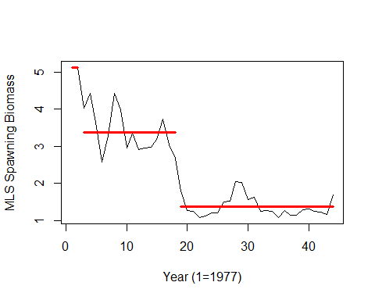
Change Point in 1995 for Spawning Stock Biomass Series
CP₂=1995

Slide 33
Sequence of 5-Year Moving Averages of Recruitment

Slide 34
Sequence of 20-Year Moving Averages of Recruitment

Slide 35
Recruitment Residuals of Medium-Term Model

Slide 36
Recruitment Residuals of Short-Term Model

Slide 37
Recruitment Residuals of Long-Term, or SRR Model

Slide 38
Squared Prediction Error by Recruitment Model

Slide 39
Annual Inverse Error-Variance Weights by Recruitment Model

Slide 40
Annual Inverse Error-Variance Weights by Recruitment Model

Slide 41
Annual Inverse Error-Variance Weights by Recruitment Model

Slide 42
Inverse Error-Variance Weights by Recruitment Model Based on 2020 and 2021 Recruitment Prediction Errors

Slide 43
Aggregate Fleet Mean Weights at Age by Assessment

Slide 44
Maturity at Age Ogives by Assessment

Slide 45
Aggregate Fleet Selectivities at Age by Assessment

Slide 46
Aggregate Fleet Yield Per Recruit by Assessment

Slide 47
Aggregate Fleet Spawning Biomass Per Recruit by Assessment

Slide 48
Aggregate Fleet Mean Generation Time by Assessment

Slide 49
Aggregate Fleet Spawning Potential Ratio by Assessment

Slide 50
9-Selectivity Fleet Groups from the 2023 Assessment

Slide 51
Domed Selectivity Fleet Groups from the 2023 Assessment

Slide 52
Flat-Topped Selectivity Fleet Groups from the 2023 Assessment

Slide 53
Proportion of Fishing Mortality by Domed Selectivity Fleet Group

Slide 54
Proportion of Fishing Mortality by Flat-Topped Selectivity Fleet Group

Slide 55
Proportion of Fishing Mortality by Fleet Group

Slide 56
Mean Catch Weights at Age by Domed Selectivity Fleet Group

Slide 57
Mean Catch Weights at Age by Flat-Topped Selectivity Fleet Group

Slide 58
Annual Catch Biomass by Domed Selectivity Fleet Group

Slide 59
Annual Catch Biomass by Flat-Topped Selectivity Fleet Group

Slide 60
Proportion of Annual Catch Biomass by Domed Selectivity Fleet Group

Slide 61
Proportion of Annual Catch Biomass by Flat-Topped Selectivity Fleet Group

Slide 62
Proportion of Catch Biomass by Fleet Group

Slide 63
Rebuilding Results: Constant Fishing Mortality

Slide 64
Rebuilding Results: Constant Catch Quota

Slide 65
Rebuilding Results: Phased Fishing Mortality

Slide 66
Rebuilding Results: Phased Catch Quota

Slide 67
Comparison of Rebuilding Scenario Results

Slide 68
Rebuilding Results: Constant Fishing Mortality

Slide 69
Rebuilding Results: Constant Catch Quota

Slide 70
Rebuilding Results: Phased Fishing Mortality

Slide 71
Rebuilding Results: Phased Catch Quota

Slide 72
Comparison of Rebuilding Scenario Results

Slide 73
Rebuilding Results: Constant Fishing Mortality

Slide 74
Rebuilding Results: Constant Catch Quota

Slide 75
Rebuilding Results: Phased Fishing Mortality

Slide 76
Rebuilding Results: Phased Catch Biomass

Slide 77
Comparison of Rebuilding Scenario Results

Slide 78
Comparison of Rebuilding Scenario Results

Slide 79
Comparison of Rebuilding Scenario Results

Slide 80
Medium-Term Recruitment Results

Slide 81
Short-Term Recruitment Results

Slide 82
Long-Term Recruitment Results

Slide 83
Medium-Term Recruitment Results

Slide 84
Short-Term Recruitment Results

Slide 85
Long-Term Recruitment Results

Slide 86
Medium-Term Recruitment Results

Slide 87
Short-Term Recruitment Results

Slide 88
Long-Term Recruitment Results

Slide 89
Medium-Term Recruitment Results

Slide 90
Short-Term Recruitment Results

Slide 91
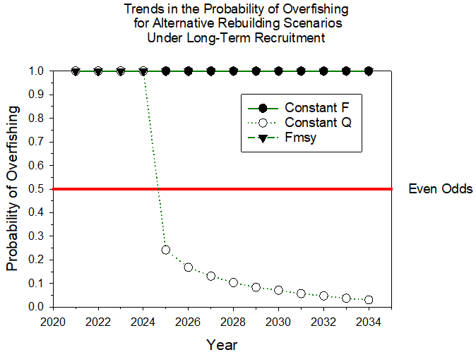
Long-Term Recruitment Results

Slide 92

~ Thanks and Mahalo !
Notes:
Thanks and Mahalo!

Slide 93
Auxiliary Slides

Slide 94
Residual Patterns for Recruitment

Slide 95
Residual Patterns for Recruitment

Slide 96
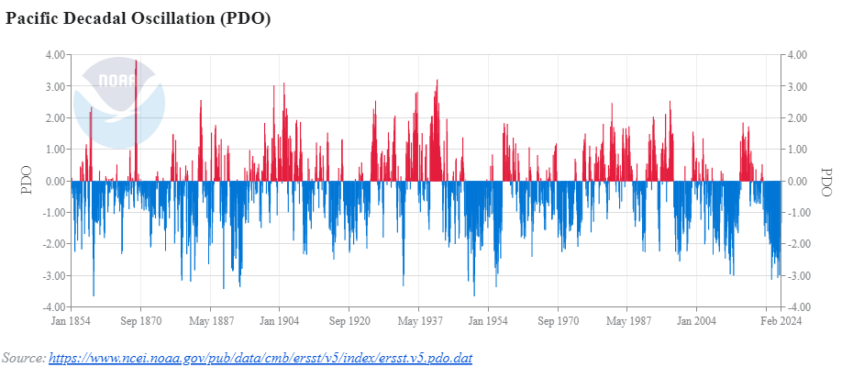
PDO: Medium-Term Environmental Forcing
August 1998

Slide 97
Temporal Change in WCNPO Striped Marlin Recruitment

Slide 98
Estimating When the Change Occurred

Slide 99
Recruitment: Estimating When the Change Occurred
Τ=1993

Slide 100
Spawning Stock Biomass: Change Points
Τ₁=1978
Τ₂=1995

Slide 101
Summarize Time Series Results
Recruitment: Nonstationary with probable AR(1) or MA(1+) processes
Spawning Biomass: Nonstationary with probable AR(1) or MA(1+) processes
Recruits Per Spawner: none
ONI: Nonstationary with probable negative serial correlation at lag 2
MEI: Same as ONI but shorter time series
PDO: Nonstationary with probable AR(1) or MA(1) processes
Source: 2024-Feb-6.pptx on https://github.com/PIFSCstockassessments/2024-WCNPO-MLS-Rebuilding

Slide 102
Preliminary Recruitment Models for Projections
Short-term recruitment (5-year ECDF): Random sampling from the Empirical Cumulative Distribution Function of Recruitment during 2016-2020
Working hypothesis is that recruitment in the next 10 years will be similar to that observed in the recent past, with a period of about 1 mean generation time (5 years)
Similar to short-term recruitment model used in 2020-2021 WCNPO Striped Marlin rebuilding plan analyses
Mean(Recruitment) = 163.0 (age-1, 000s)
CV(Recruitment) = 33%

Slide 103
Preliminary Recruitment Models for Projections
Medium-term recruitment (20-year ECDF): Random sampling from the Empirical Cumulative Distribution Function of Recruitment during 2001-2020
Working hypothesis is that recruitment in the next 10 years will be similar to that observed in the past 2 decades, with a period of about 4 mean generation times
Matches the time window used to calculate the dynamic unfished Spawning Stock Biomass for the WCNPO Striped Marlin F20% reference points. Matches recommendation for additional recruitment hypothesis from the WPRFMC’s Scientific and Statistical Committee
Mean(Recruitment) = 171.6 (age-1, 000s)
CV(Recruitment) = 45%

Slide 104
Preliminary Recruitment Models for Projections
Long-term recruitment (Beverton-Holt Curve Fitted in Base Case Assessment Model): Random sampling from the expected stock-recruitment curve with lognormal error
Working hypothesis is that recruitment in the next 10 years will be similar to that observed over the assessment time period of 1977-2020
Long-term recruitment model assumes stationarity of recruitment dynamics in 1977-2020
Modified Beverton-Holt parameters: h = 0.87, R₀ = 405.8, SSB₀ = 19278.8, σ_{R} = 0.6
Mean(Predicted Recruitment) = 301.3 (age-1, 000s)
CV(Predicted Recruitment) = 14%

Slide 105
Set Recruitment Model Weights
Use a Tactical Approach (Dormann et al. 2018) Based on Predictive Accuracy
Use out-of-sample predictions for most recent observed recruitments in 2020-2021 (age-1)
Use 5-year ECDF from 2015-2019 for short-term prediction algorithm
Use 20-year ECDF from 2002-2019 for medium-term prediction algorithm
Use expected recruitment from fitted Beverton-Holt curve for long-term prediction

Slide 106
Recruitment Predictions for Age-1 in 2020 and 2021 to Calculate Mean Squared Error and Inverse Variance Weights for each Recruitment Model

Slide 107
Recruitment Predictions for Age-1 in 2020 and 2021 to Calculate Mean Squared Error and Inverse Variance Weights for each Recruitment Model

Slide 108
Results of Reweighting Based on the Estimated Standard Error of the Point Estimate of Recruitment: Calculate Weights for 2020-2021 Based on Variance of Recruitment

Slide 109
Results of Reweighting Based on the Estimated Standard Error of the Point Estimate of Recruitment: Combining the Annual Weights with the Inverse Variance Predictive Accuracy Weights

